Slide 1
State Tax Reforms in a Federalist System
O’Neill School of Public and Environmental Affairs
Luis Navarro*, Craig L. Johnson, Andrey Yushkov, Bahawal Sharyar
Presentation for the
ABFM Conference
INDIANA UNIVERSITY BLOOMINGTON

Slide 2
Introduction
This paper provides an exploration on the determinants of state personal income tax (PIT) reforms.
Using data from the Tax Foundation, we provide a characterization of long-term trends on state income tax reforms.
This talk: Income Tax Policy --> Top PIT Rates
We examine and test a theory of fiscal space as determinant of state income tax reform.
Findings preview: i) Federal IG revenues play a mayor role on the determination of state PIT policy; ii) an increase in federal transfers increases the probability of tax reductions.
Notes:
At first sight, the relationship between these variables is not straightforward.
If the government is helping you, is because you might need it.

Slide 3
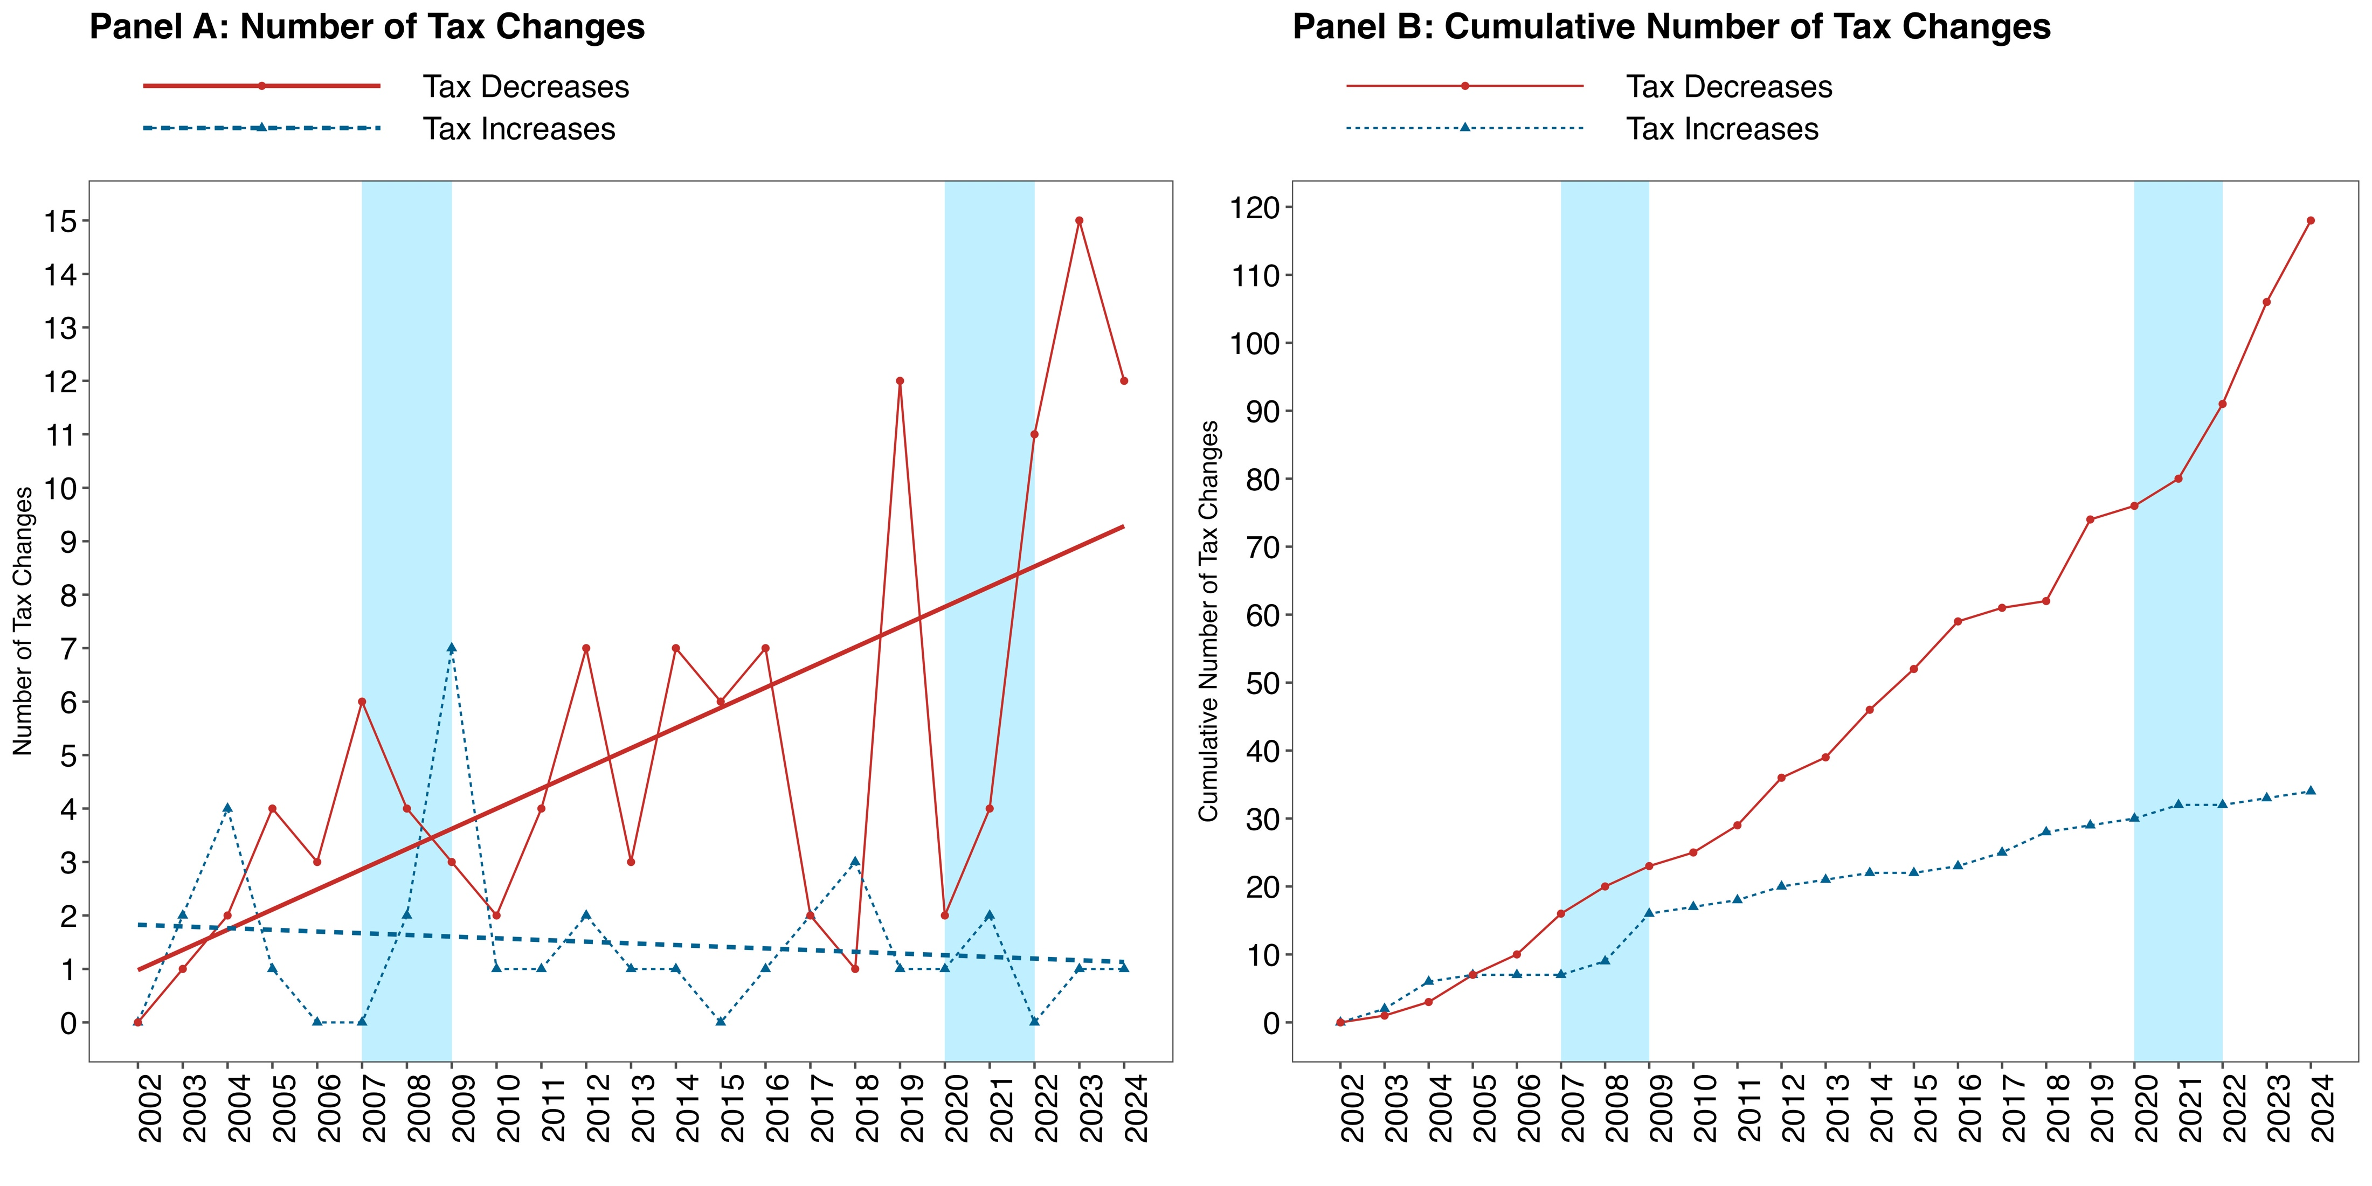
Since the early 2000, we have observed a rising trend on cuts on the top PIT rate.
Total Tax Decreases: 118
Total Tax Increases: 34
Between 2022-2024, a total of 40 tax changes (38 decreases and 2 increases)
Source: Figure 1 at Johnson et al. (2024).Note: Calculations exclude states without a PIT rate. Tax changes for 2002 are not included since our analysis starts on this date. Panel A shows the number of tax changes observed in each year. Panel B shows the cumulative sum of the number of tax changes observed in each year. Both panels show individual lines according to the type of tax policy implemented (i.e., tax increase or tax decrease). Shaded areas correspond to the period of the Great Recession and the COVID-19 pandemic emergency.
Notes:
At first sight, the relationship between these variables is not straightforward.
If the government is helping you, is because you might need it.

Slide 4
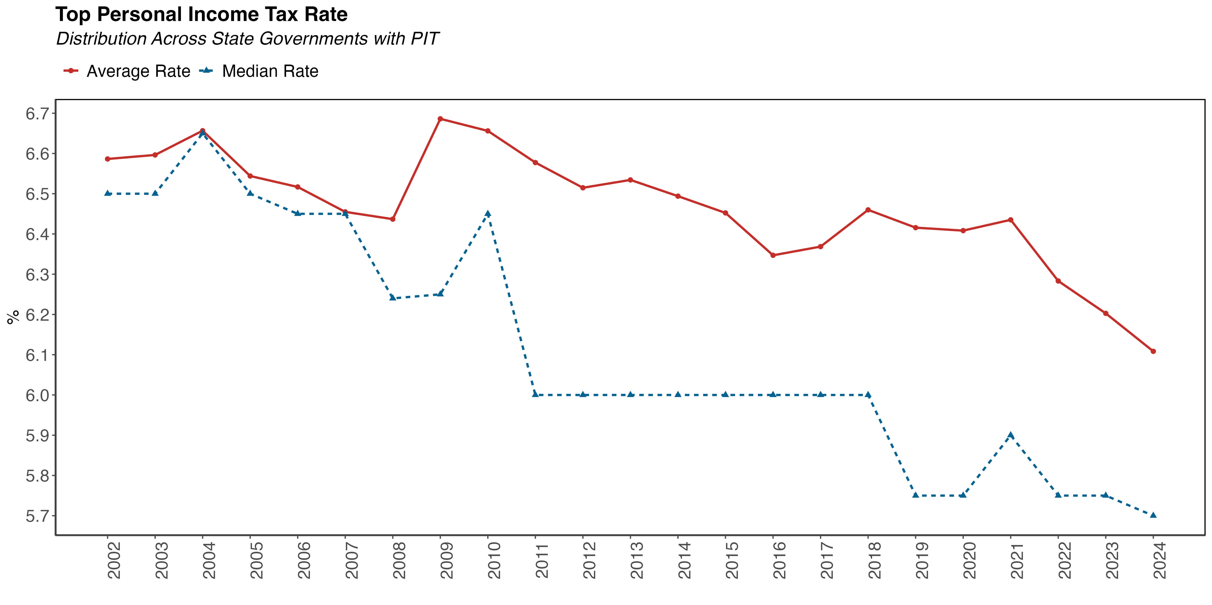
This has translated in a decrease on the average (and median) state top PIT rates.
Note: This graph shows the average (and median) top PIT rate across states that levy a personal income tax.
Notes:
At first sight, the relationship between these variables is not straightforward.
If the government is helping you, is because you might need it.

Slide 5
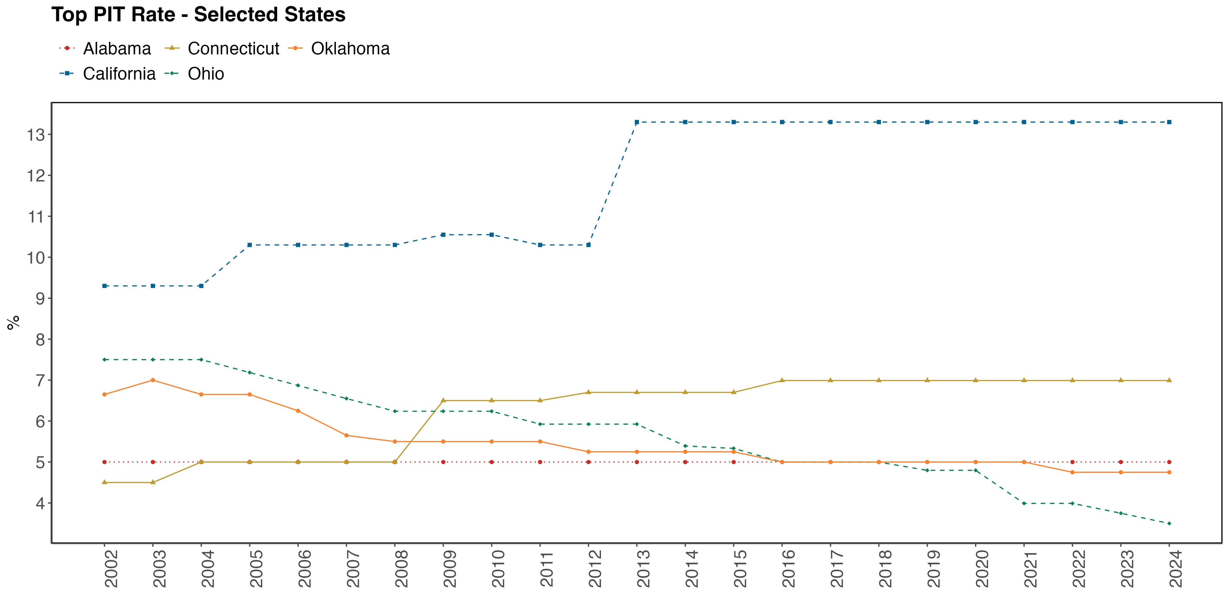
Approach to PIT reform has been heterogenous across states.
Note: This graph shows the top PIT rate for some selected states.
Notes:
At first sight, the relationship between these variables is not straightforward.
If the government is helping you, is because you might need it.

Slide 6
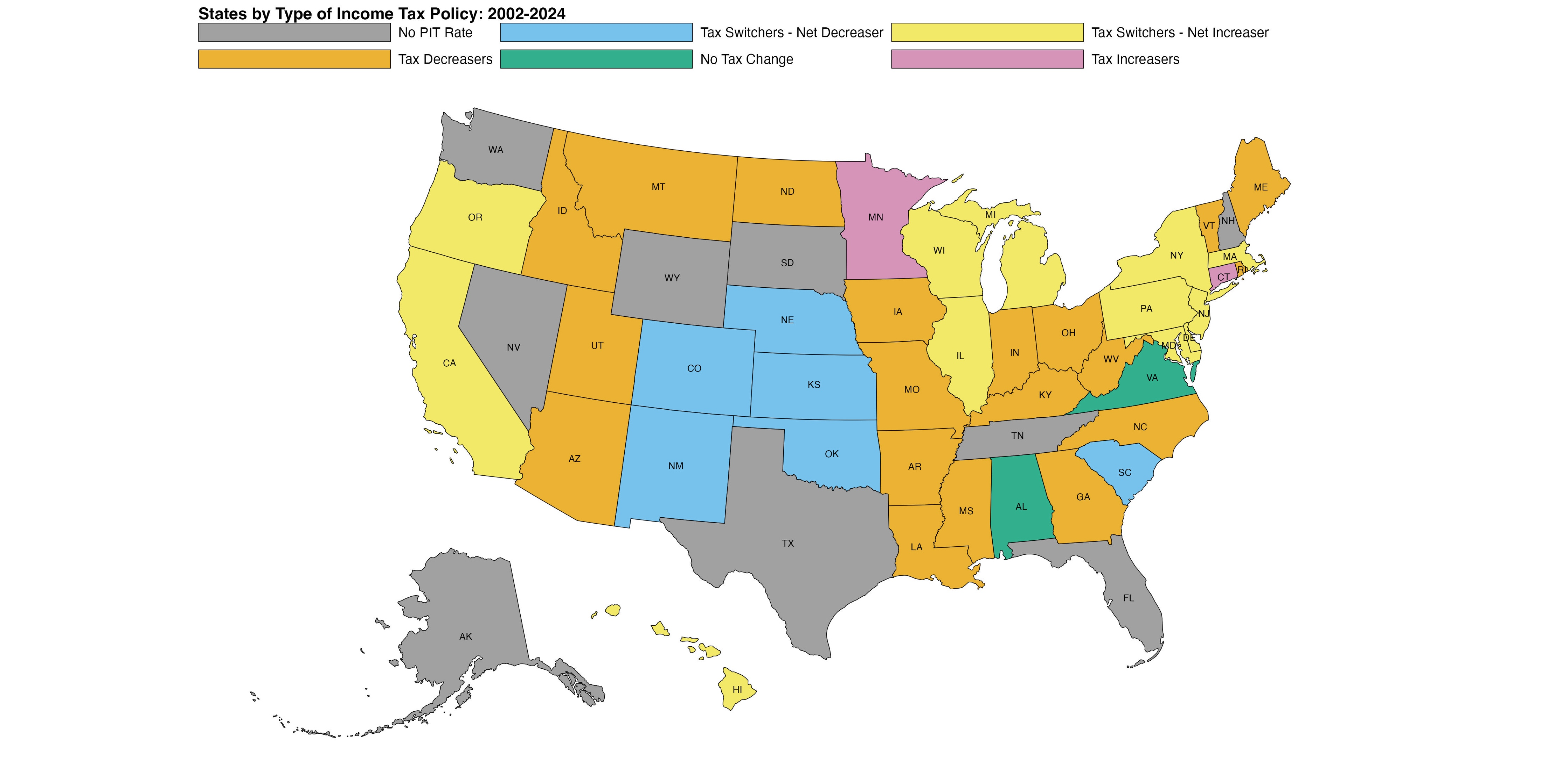
Income Tax Policy Classification – Long Term (Fixed) Classification
Considering the trajectory of each state top PIT rate, we assign them to one of the following categories.
No PIT Rate (9): states that do not levy a personal income tax.
No Tax Change (2): the PIT rate remained constant through all periods.
Tax Decreasers (19): The PIT rate is monotonically ⬇️ over time. All changes on the PIT rate were negative.
Tax Increasers (2): The PIT rate is monotonically ⬆️ over time. All changes on the PIT rate were positive.
Tax Switchers - Net Decreasers (6): changes on the PIT rate were either positive or negative, but the net change (cumulative sum of tax changes) is negative.
Tax Switchers - Net Increasers (12): changes on the PIT rate were either positive or negative, but the net change (cumulative sum of tax changes) is positive.
Note: this map shows the long-term classification of states income tax policy using the categorization algorithm described above.
Notes:
At first sight, the relationship between these variables is not straightforward.
If the government is helping you, is because you might need it.

Slide 7
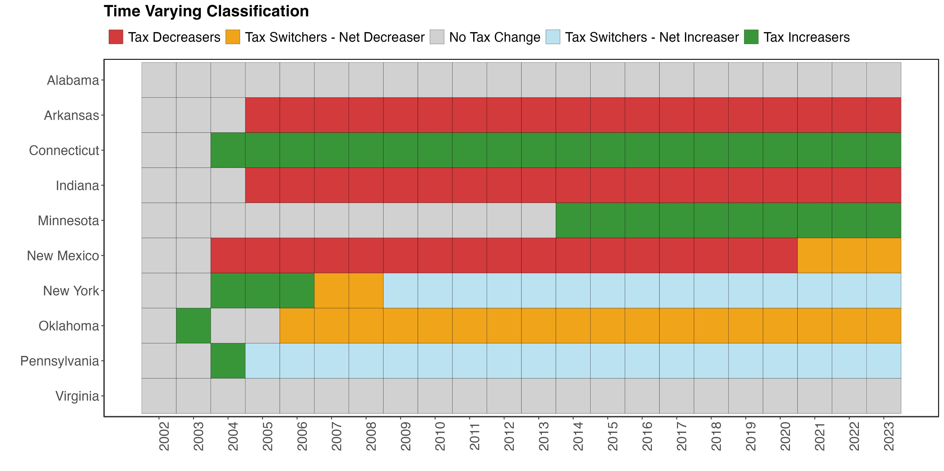
Income Tax Policy Classification – Time-Varying Classification
Note: this diagram shows how some selected states are classified into one of the categories, given their observed trajectory on PIT rates.
Notes:
At first sight, the relationship between these variables is not straightforward.
If the government is helping you, is because you might need it.

Slide 8
Research Question and Hypotheses
Research Question: what are the main determinants behind state personal income tax reform?
Fiscal Space: room in a government´s budget that allows it to provide resources for a desired purpose without jeopardizing the sustainability of its financial position or the stability of the economy. (IMF)
Theory: states with more fiscal space are more likely to decrease taxes (and viceversa).
Measures of Fiscal Space: i) Fed IG Transfers; ii) Outstanding Debt; iii) Net Operating Balance; iv) General Fund (GF) Balance. (Expressed as % of state GDP).
 | Fiscal Space | Pr(Tax Decrease) | Pr(Tax Increase)
Fed IG Transfers | + | + | -
Outstanding Debt | - | - | +
Fiscal Balance | + | + | -
GF Balance | + | + | -
Testable Hypotheses
Notes:
At first sight, the relationship between these variables is not straightforward.
If the government is helping you, is because you might need it.

Slide 9
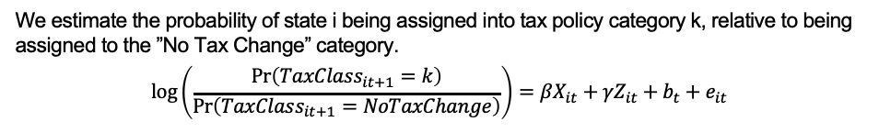
Empirical Model
Multinomial Logit Model
We estimate the probability of state i being assigned into tax policy category k, relative to being assigned to the ”No Tax Change” category.
$$\log\left(\frac{\operatorname{Pr}\left(TaxClass_{it+1}=k\right)}{\operatorname{Pr}\left(TaxClass_{it+1}=NoTaxChange\right)}\right)=βX_{it}+γZ_{it}+b_{t}+e_{it}$$
Econometric Specification
Dep var: i) fixed (long-term) classification; ii) time-varying (dynamic) classification.
Indep vars (X): vector of fiscal space variables, % state GDP.
Controls (Z): political affiliation of state governor and house, % sales tax revenue to total revenue, unemployment rate. Models with and without year fixed effects.
We report marginal effects, with robust standard errors.
Notes:
I study the quasi-experimental setting created by the CRF using the intuition behind a Regression Discontinuity Design.

Slide 10
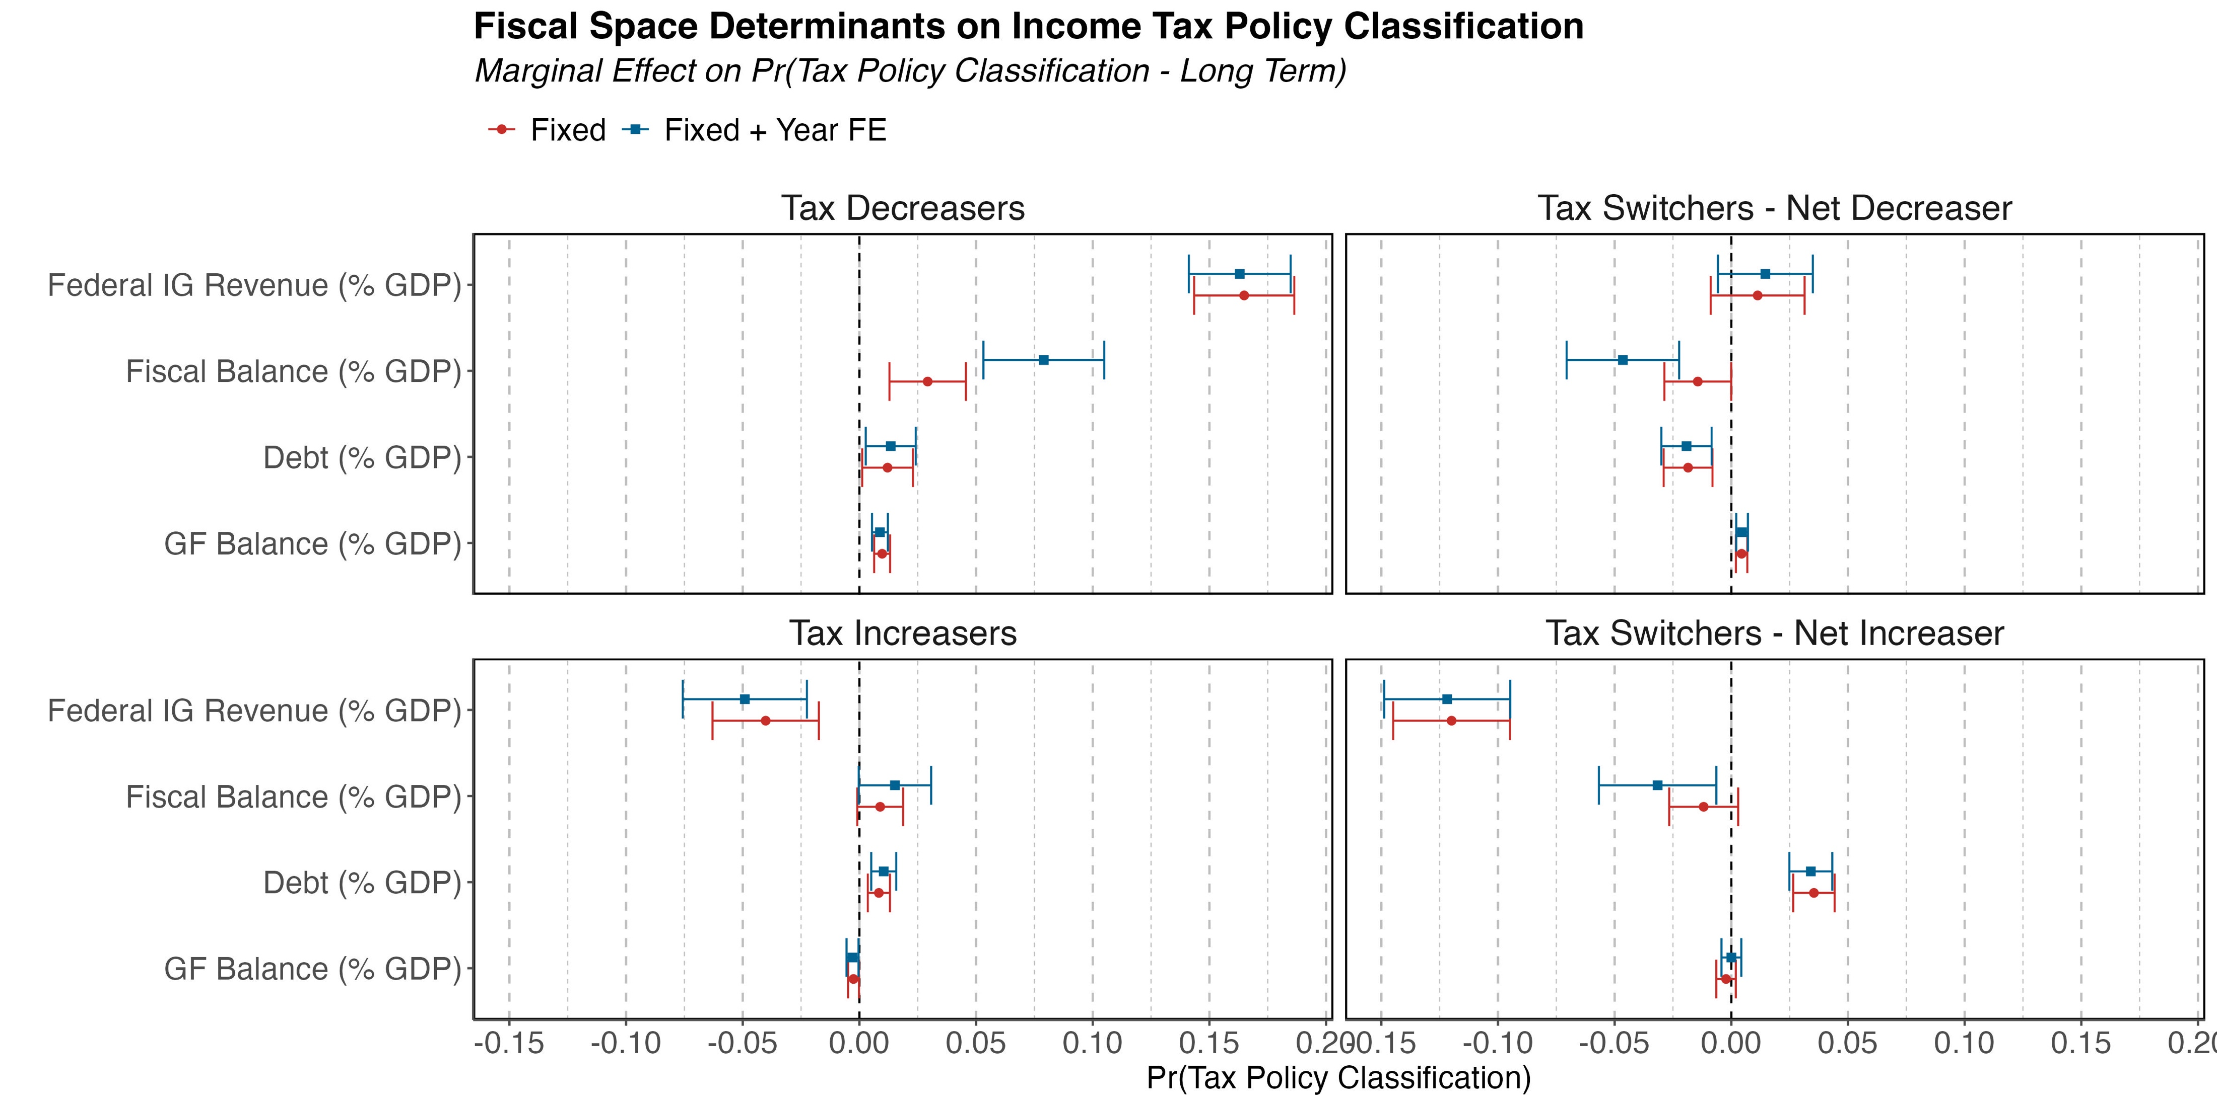
Results – Fixed (Long Term) Classification
Marg. Eff. | Eff. Size
Tax Decreasers
0.163*** | 35.2%
0.079*** | 17.0%
0.0134** | 2.9%
0.008*** | 1.9%
Tax Switchers - Net Increaser
-0.1217*** | -41.6%
-0.0316*** | -10.8%
0.0341*** | 11.7%
0.0001 | 0.03%
Note: this graph show the marginal effects of the determinants of fiscal space on the probability of being assigned into one of the income tax categories, relative to the probability of being assigned to No Tax Change. Robust standard errors used to compute confidence intervals.
Notes:
At first sight, the relationship between these variables is not straightforward.
If the government is helping you, is because you might need it.

Slide 11
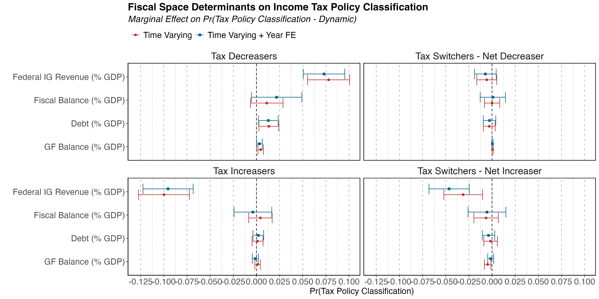
Results – Time Varying (Dynamic) Classification
Marg. Eff. | Eff. Size
Tax Decreasers
0.073*** | 25.2%
0.0218 | 7.52%
0.0129** | 4.45%
0.0033** | 1.14%
Tax Switchers - Net Increaser
-0.0464*** | -32.3%
-0.0055 | -3.83%
-0.0038 | -2.65%
-0.0014 | -0.975%
Note: this graph show the marginal effects of the determinants of fiscal space on the probability of being assigned into one of the income tax categories, relative to the probability of being assigned to No Tax Change. Robust standard errors used to compute confidence intervals.
Notes:
At first sight, the relationship between these variables is not straightforward.
If the government is helping you, is because you might need it.

Slide 12
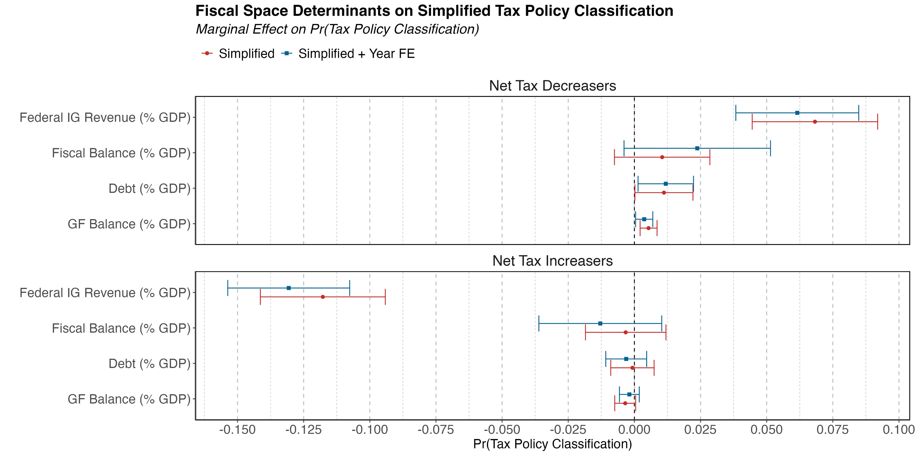
Robustness Check – Simplified Model
Marg. Eff. | Eff. Size
Net Tax Decreasers
0.0616*** | 19.2%
0.0238* | 7.42%
0.0119** | 3.72%
0.0037** | 1.15%
Net Tax Increaser
-0.1306*** | -49.7%
-0.0129 | -4.83%
-0.0031 | -1.17%
-0.0019 | -0.72%
Note: this graph show the marginal effects of the determinants of fiscal space on the probability of being assigned into one of the income tax categories, relative to the probability of being assigned to No Tax Change. Robust standard errors used to compute confidence intervals.
Notes:
At first sight, the relationship between these variables is not straightforward.
If the government is helping you, is because you might need it.

Slide 13
Summary: an increase in Federal IG Revenues equivalent to 1% of GDP:
Dep Var | Tax Policy | Hyp | Marginal Effect | Effect Size (% Mean Dep Var)
Fixed (Long-Term) Classification | Decreaser | + | 0.1630*** | 35.2%
 | Net Decreaser | + | 0.0146 | 9.98%
 | Net Increaser | - | -0.1217*** | -41.6%
 | Increaser | - | -0.0491*** | -101%
Time-Varying (Dynamic) Classification | Decreaser | + | 0.073*** | 25.2%
 | Net Decreaser | + | -0.0072 | -24.2%
 | Net Increaser | - | -0.0464*** | -32.3%
 | Increaser | - | -0.0955*** | -80.1%
Simplified Classification | Net Decreaser | + | 0.0616*** | 19.26%
 | Net Increaser | - | -0.1306*** | -49.67%
Notes:
At first sight, the relationship between these variables is not straightforward.
If the government is helping you, is because you might need it.

Slide 14
Discussion and Next Steps
There is a long-term trend on decreasing PIT rates among state governments.
Empirical results suggest that Federal IG transfers play a significant role in the determination of state income tax policy.
Larger reliance on federal IG revenues reduces the likelihood of net tax increases and viceversa. Finding consistent with fiscal replacement literature (Gramlich, 1987).
Next steps: address potential endogeneity between Fed IG revenues and Income Tax Policy. IV residual inclusion approach. Cluster-bootstrap algorithm to get cluster-robust SE by state.

Slide 15

Thanks for your attention!
Scan to learn more about this project.
I am in the Job Market!
Contact: Luis Navarro lunavarr@iu.edu

Slide 16
Appendix

Slide 17
Income Tax Policy Classification
Considering the trajectory of each state top PIT rate, we assign them to one of the following categories.
No PIT Rate (9): states that do not levy a personal income tax.
No Tax Change (2): the PIT rate remained constant through all periods.
Tax Decreasers (19): The PIT rate is monotonically decreasing over time. All changes on the PIT rate were negative.
Tax Increasers (2): The PIT rate is monotonically increasing over time. All changes on the PIT rate were positive.
Tax Switchers - Net Decreasers (6): changes on the PIT rate were either positive or negative, but the net change (cumulative sum of tax changes) is negative.
Tax Switchers - Net Increasers (12): changes on the PIT rate were either positive or negative, but the net change (cumulative sum of tax changes) is positive.
Notes:
At first sight, the relationship between these variables is not straightforward.
If the government is helping you, is because you might need it.

Slide 18
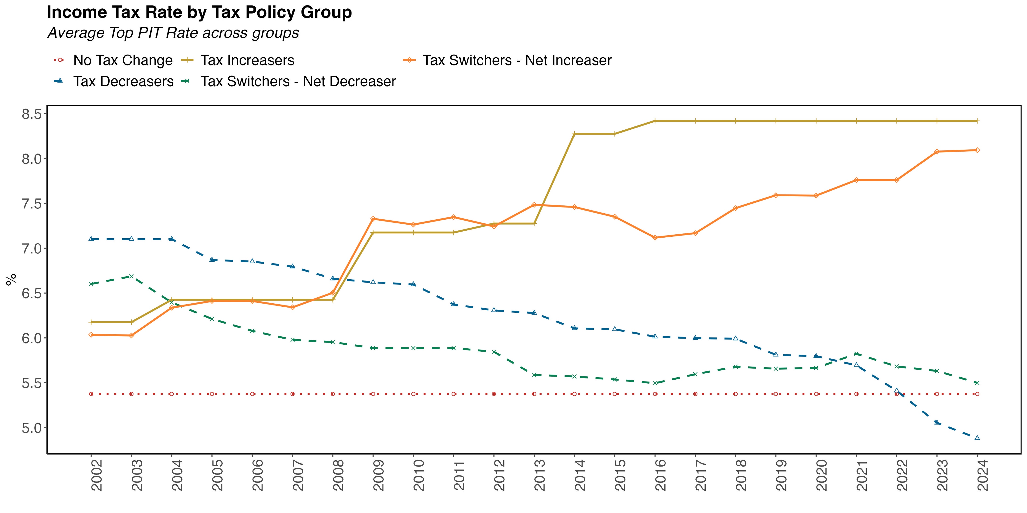
Note: This graph shows the top PIT rate for some selected states.
Notes:
At first sight, the relationship between these variables is not straightforward.
If the government is helping you, is because you might need it.

Slide 19
State Tax Reforms in a Federalist System
O’Neill School of Public and Environmental Affairs
Luis Navarro*, Craig L. Johnson, Andrey Yushkov, Bahawal Sharyar
Presentation for the
ABFM Conference
INDIANA UNIVERSITY BLOOMINGTON

